Slide 1
Score Results
One America Works Capstone Team

Slide 2
All variables included:
[1] "MSA" "State" "Lat" [4] "Long" "NumAirline" "GDP" [7] "Tech_Hub" "AvgStateTax" "AvgPropTaxPerCap" [10] "LandArea" "PopDensity" "Age2534" [13] "MedianIncome" "PercentBach" "PovertyRate" [16] "HealthCareIndex" "CrimeIndex" "PurchasingPower" [19] "CPIIndex" "PollutionIndex" "TrafficIndex" [22] "QualityofLifeIndex" "RentIndex" "PropPricetoIncomeRatio" [25] "CO2Index" "NumTechConf" "TotEnrollment" [28] "AvgSchoolRep" "AvgTuition" "Electricity" [31] "NatGas" "CorpTaxMin" "CorpTaxMax" [34] "CostLivingComposit" "WCIndex" "TaxableWageBase" [37] "SingEmpCost" "FamilyEmpCost" "GDP5Year" [40] "Poplutation" "MaleFemaleRatio" "Under5" [43] "Bet5and9" "Bet10and14" "Bet15and19" [46] "Bet20and24" "Bet25and34" "Bet35and44" [49] "Bet45and54" "Bet55and59" "Bet60and64" [52] "Bet65and74" "Bet75and84" "AtorOver85" [55] "MedianAge" "Labor" "LaborForceAnnGrowth" [58] "GDPperCap" "CBRE_TechScore" "CBRE_Tech_Talent" [61] "CBRE_change_12_17" "CBRE_Volume_12_17" "CBRE_Concentration_17" [64] "CBRE_17_Tech_Degrees" "CBRE_Growth_12_17" "CBRE_Brain" [67] "CBRE_AvgRent_75K" "CBRE_Vacancy_Rate" "CBRE_Avg_monthly_Apartment_Rent" [70] "CBRE_Costofliving" "CBRE_AvgAnn_TechWage" "CBRE_Rent_to_Tech_WageRatio" [73] "CBRE_MILLENNIAL_Pop" "CBRE_WageRelativetoUSAvg" "CBRE_TalentWage_5Yr_Growth" [76] "CBRE_Office_Vacancy_Rate_13" "RevPerCap0" "RevPerCap11" [79] "RevPerCap21" "RevPerCap22" "RevPerCap23" [82] "RevPerCap31_33" "RevPerCap42" "RevPerCap44_45" [85] "RevPerCap48_49" "RevPerCap51" "RevPerCap52" [88] "RevPerCap53" "RevPerCap54" "RevPerCap56" [91] "RevPerCap61" "RevPerCap62" "RevPerCap71" [94] "RevPerCap72" "RevPerCap81" "RevPerCap55" [97] "RevPerCap99" "PerofRev0" "PerofRev11" [100] "PerofRev21" "PerofRev22" "PerofRev23" [103] "PerofRev31_33" "PerofRev42" "PerofRev44_45" [106] "PerofRev48_49" "PerofRev51" "PerofRev52" [109] "PerofRev53" "PerofRev54" "PerofRev56" [112] "PerofRev61" "PerofRev62" "PerofRev71" [115] "PerofRev72" "PerofRev81" "PerofRev55" [118] "PerofRev99" "Patents" "VCInvPer" [121] "VCFirms" "Amazon" "TopGrad" [124] "numairport" "asai" "densityscore" [127] "landusescore" "activityscore" "streetscore" Added region and subregion Also engineered a TecRev variable
>

Slide 3
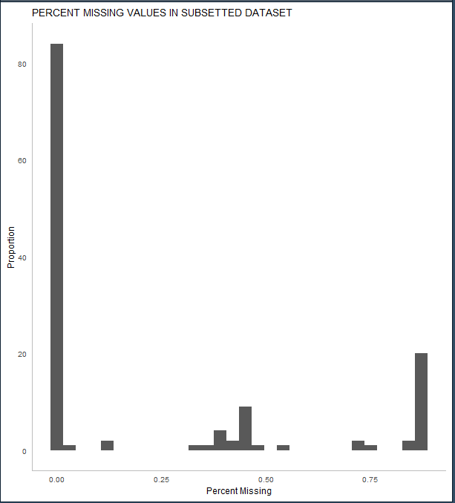
Missing Data

Slide 4
Next steps
Imputation, variable engineering, normalization
PCA on Rev Breakdown and on AgeGroups
Separate Variables in 4 categories: Talent, Connectivity, Cost, QualityofLIfe

Slide 5
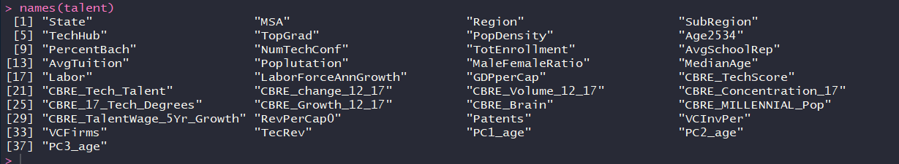
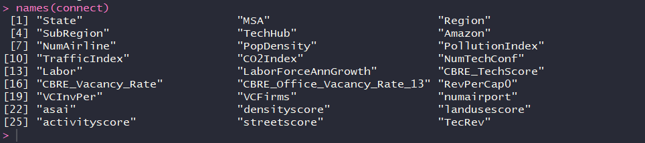
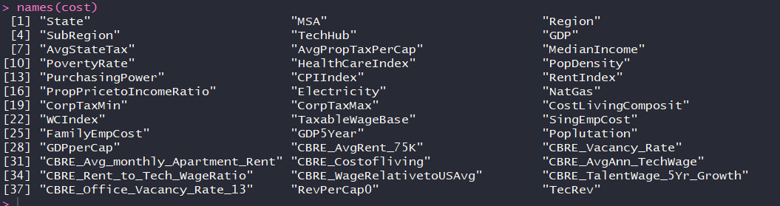
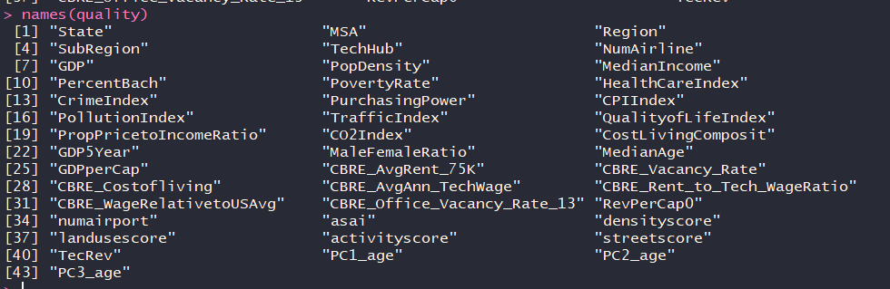
Mapping of variables
Q: Comments on Mapping?

Slide 6
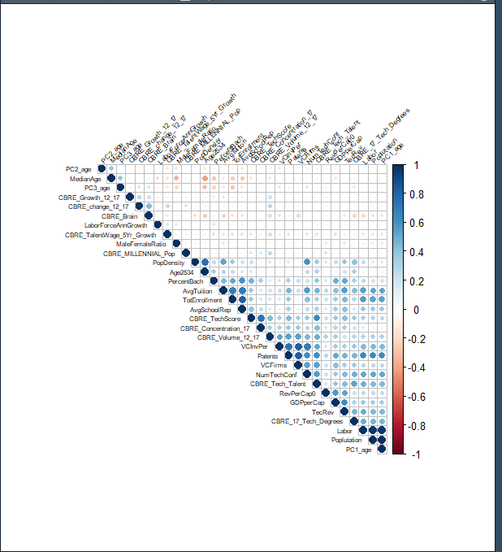
Cor Matrix - talent

Slide 7
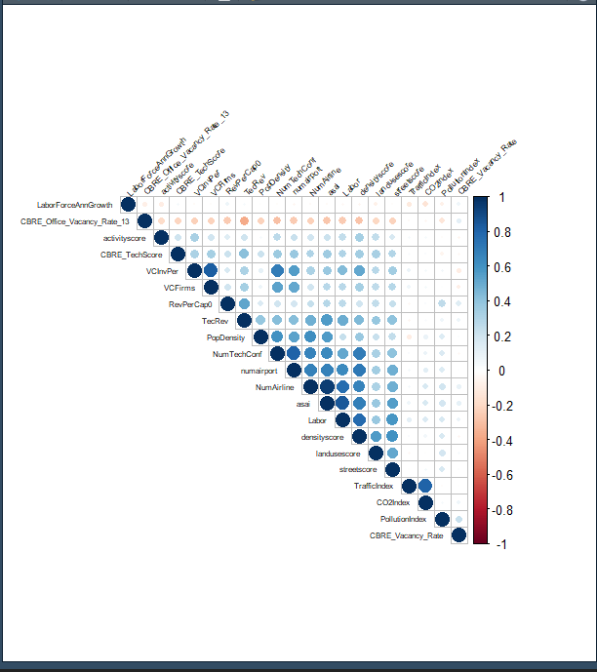
Cor Matrix - connect

Slide 8
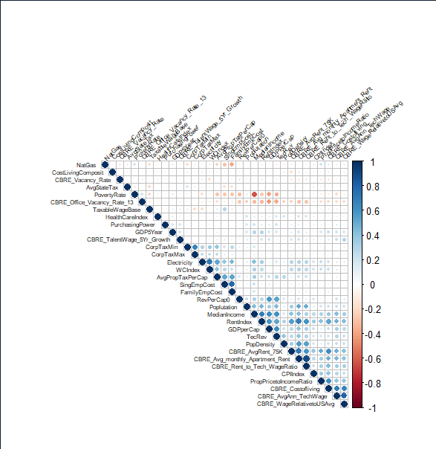
Cor Matrix - cost

Slide 9
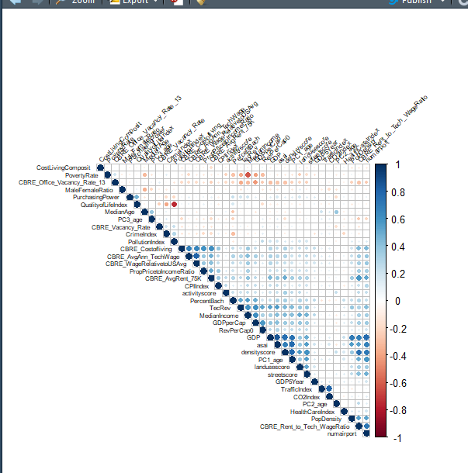
Cor Matrix - quality

Slide 10
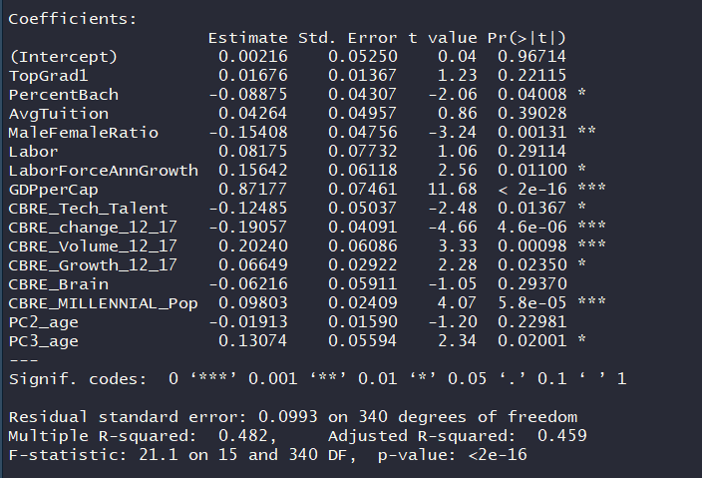
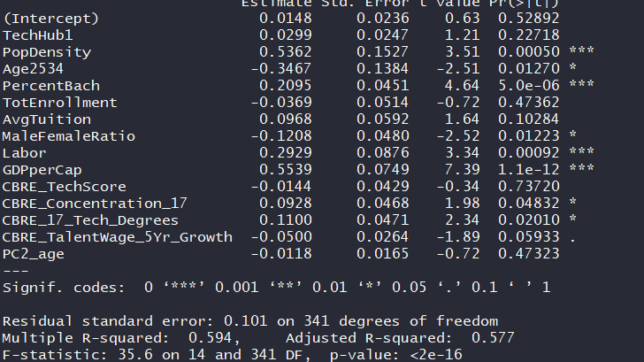
Talent Regression (after Ridge, etc)
On Rev0
On TecRev – Better

Slide 11
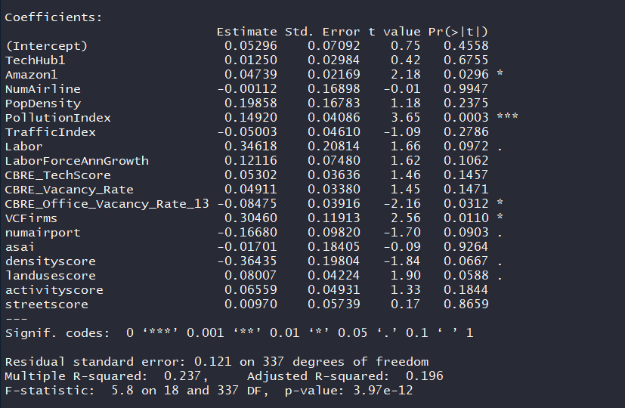
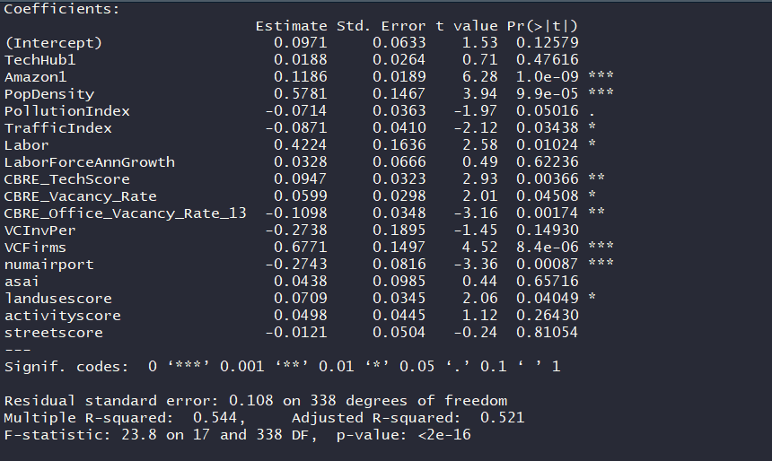
Connect Regression (after Ridge, etc)
On Rev0
On TecRev – Better

Slide 12
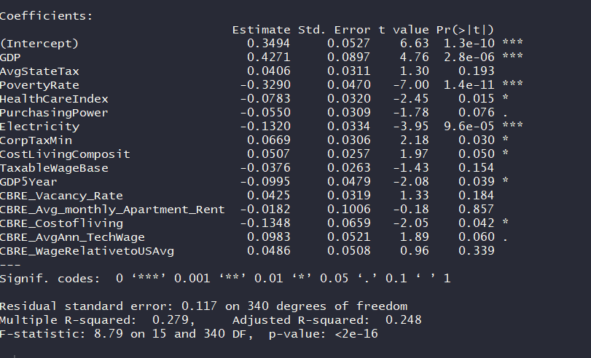
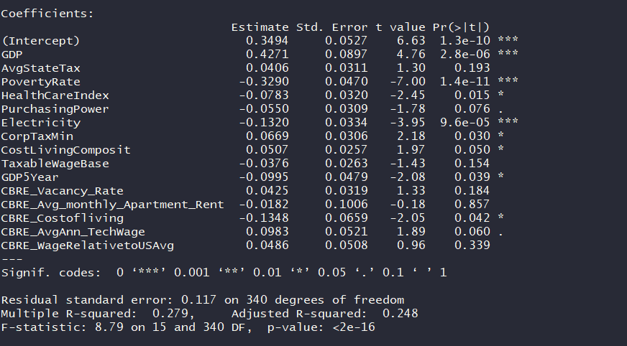
Cost Regression (after Ridge, etc)
On Rev0
On TecRev – Better

Slide 13
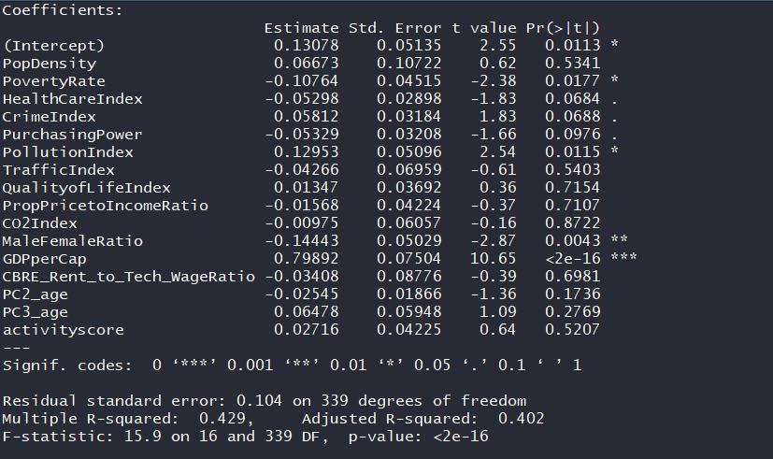
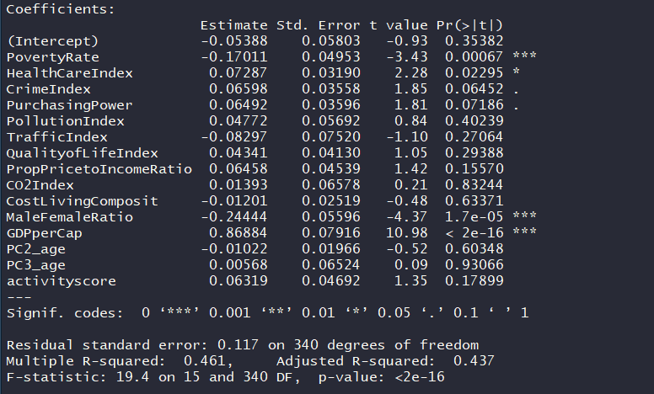
Quality Regression (after Ridge, etc)
On Rev0
On TecRev – Better

Slide 14
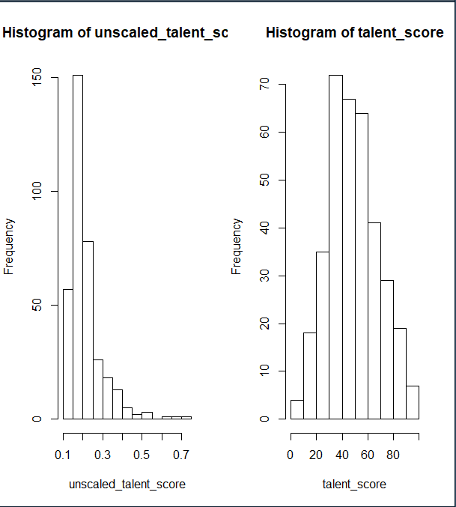
Variable Importance - Talent
unscaled_talent_score <- 0.085041607*combo$TechHub + 0.019206753*combo$TopGrad + 0.017551347*combo$Age2534 + 0.184487864*combo$PercentBach +
0.074054465*combo$TotEnrollment + 0.170142322*combo$AvgTuition + -0.057845876*combo$AvgSchoolRep + -0.020068509*combo$MaleFemaleRatio +
0.091434420*combo$Labor + -0.004399969*combo$MedianAge + 0.001428946*combo$LaborForceAnnGrowth + 0.045167181*combo$CBRE_Tech_Talent +
0.046374675*combo$CBRE_Concentration_17 + 0.087486679*combo$CBRE_17_Tech_Degrees + 0.002826917*combo$CBRE_TalentWage_5Yr_Growth +
0.087691603*combo$Patents + -0.004790866*combo$PC2_age
#lmg
#TechHub 0.085041607
#TopGrad 0.019206753
#Age2534 0.017551347
#PercentBach 0.184487864
#TotEnrollment 0.074054465
#AvgTuition 0.170142322
#AvgSchoolRep 0.057845876
#MaleFemaleRatio 0.020068509
#Labor 0.091434420
#MedianAge 0.004399969
#LaborForceAnnGrowth 0.001428946
#CBRE_Tech_Talent 0.045167181
#CBRE_Concentration_17 0.046374675
#CBRE_17_Tech_Degrees 0.087486679
#CBRE_TalentWage_5Yr_Growth 0.002826917
#Patents 0.087691603
#PC2_age 0.004790866
Dist b\f and after normalization
Q- normal adjustment? Or do you prefer uniform?
Q: Adjustments to weight?

Slide 15
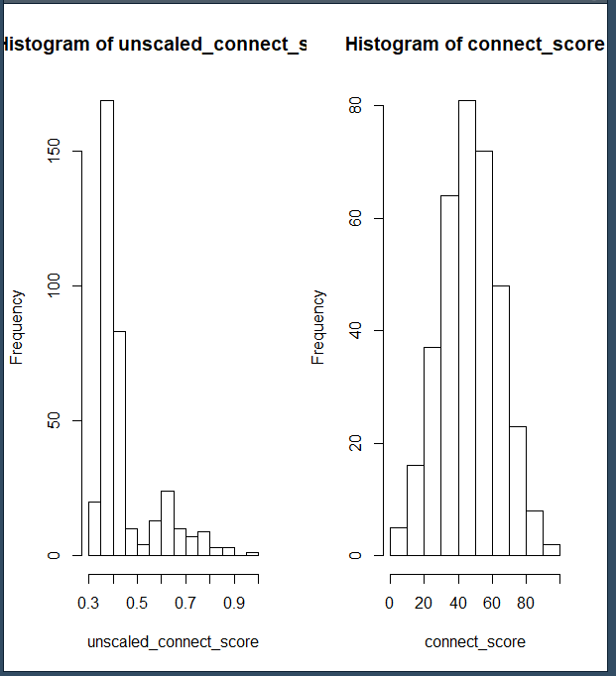
Variable Importance - Connect
unscaled_connect_score <- 0.057922912*combo$TechHub + 0.205354036*combo$Amazon + 0.050465602*combo$PopDensity + 0.006893477*combo$PollutionIndex +
0.009627496*combo$TrafficIndex + 0.085379363*combo$Labor + 0.002722620*combo$LaborForceAnnGrowth + 0.082586424*combo$CBRE_TechScore +
0.008213789*combo$CBRE_Vacancy_Rate + 0.086012042*combo$CBRE_Office_Vacancy_Rate_13 + 0.033391318*combo$VCInvPer +
0.068289190*combo$VCFirms + 0.050058256*combo$numairport + 0.128385800*combo$asai + 0.063676985*combo$landusescore +
0.013142098*combo$activityscore + 0.047878593*combo$streetscore
#lmg
#TechHub 0.057922912
#Amazon 0.205354036
#PopDensity 0.050465602
#PollutionIndex 0.006893477
#TrafficIndex 0.009627496
#Labor 0.085379363
#LaborForceAnnGrowth 0.002722620
#CBRE_TechScore 0.082586424
#CBRE_Vacancy_Rate 0.008213789
#CBRE_Office_Vacancy_Rate_13 0.086012042
#VCInvPer 0.033391318
#VCFirms 0.068289190
#numairport 0.050058256
#asai 0.128385800
#landusescore 0.063676985
#activityscore 0.013142098
#streetscore 0.047878593
Dist b\f and after normalization

Slide 16
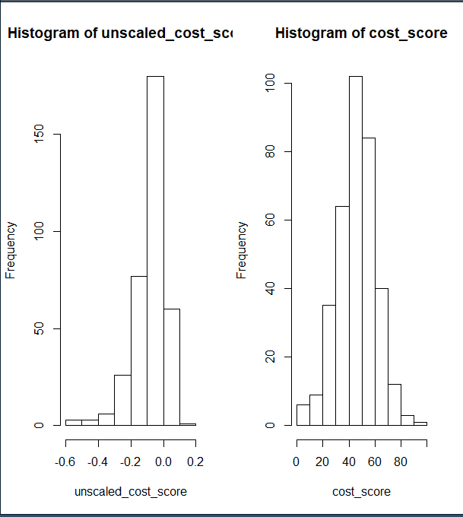
Variable Importance - Cost
unscaled_cost_score <- -0.0012212756*combo$AvgStateTax + -0.0627961272*combo$AvgPropTaxPerCap + -0.3140204253*combo$MedianIncome +
0.0988799276*combo$PovertyRate + -0.0166692394*combo$HealthCareIndex + 0.0296597584*combo$PurchasingPower + -0.0067434924*combo$CPIIndex +
-0.1863926246*combo$RentIndex + -0.0072617969*combo$PropPricetoIncomeRatio + -0.0161252065*combo$WCIndex + -0.0181598674*combo$CorpTaxMax +
-0.0004284582*combo$CostLivingComposit + -0.0170793878*combo$SingEmpCost + -0.0167659913*combo$CBRE_Costofliving +
-0.0480421580*combo$CBRE_Rent_to_Tech_WageRatio + -0.0127206338*combo$CBRE_WageRelativetoUSAvg + 0.1185163858*combo$CBRE_Office_Vacancy_Rate_13 +
-0.0285172437*combo$CBRE_AvgAnn_TechWage
#Relative importance metrics: (use lmg)
#AvgStateTax 0.0012212756
#AvgPropTaxPerCap 0.0627961272
#MedianIncome 0.3140204253
#PovertyRate 0.0988799276
#HealthCareIndex 0.0166692394
#PurchasingPower 0.0296597584
#CPIIndex 0.0067434924
#RentIndex 0.1863926246
#PropPricetoIncomeRatio 0.0072617969
#WCIndex 0.0161252065
#CorpTaxMax 0.0181598674
#CostLivingComposit 0.0004284582
#SingEmpCost 0.0170793878
#CBRE_Costofliving 0.0167659913
#CBRE_Rent_to_Tech_WageRatio 0.0480421580
#CBRE_WageRelativetoUSAvg 0.0127206338
#CBRE_Office_Vacancy_Rate_13 0.1185163858
#CBRE_AvgAnn_TechWage 0.0285172437
Dist b\f and after normalization

Slide 17
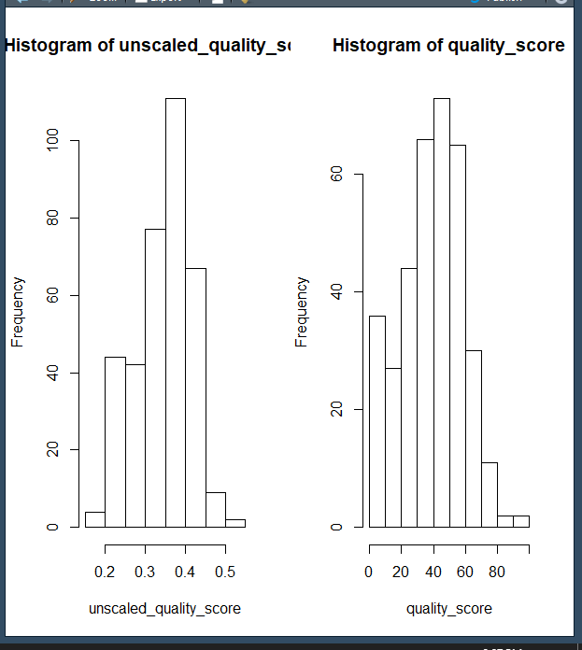
Variable Importance - Quality
quality_score <- 0.1685269613*combo$PovertyRate + 0.0325338054*combo$HealthCareIndex + 0.0050658113*combo$CrimeIndex + 0.0385033805*combo$PurchasingPower +
0.1101468110*combo$PollutionIndex + 0.0545183038*combo$TrafficIndex + 0.2601026410*combo$QualityofLifeIndex +
0.0696343548*combo$PropPricetoIncomeRatio+ 0.0021069460*combo$CO2Index+ 0.0007701137*combo$CostLivingComposit +
0.0564075905*combo$MaleFemaleRatio + 0.0521098376*combo$GDPperCap + 0.0047993471*combo$PC2_age+ 0.0083087862*combo$PC3_age +
0.1364653098*combo$activityscore
#Relative importance metrics: (use lmg)
#PovertyRate 0.1685269613
#HealthCareIndex 0.0325338054
#CrimeIndex 0.0050658113
#PurchasingPower 0.0385033805
#PollutionIndex 0.1101468110
#TrafficIndex 0.0545183038
#QualityofLifeIndex 0.2601026410
#PropPricetoIncomeRatio 0.0696343548
#CO2Index 0.0021069460
#CostLivingComposit 0.0007701137
#MaleFemaleRatio 0.0564075905
#GDPperCap 0.0521098376 - give 25 percent to quality of life index, 10% to activity, 10% to Pollution, 5% to traffic, and 5% to price to income
#PC2_age 0.0047993471
#PC3_age 0.0083087862
#activityscore 0.1364653098
Dist b\f and after normalization

Slide 18
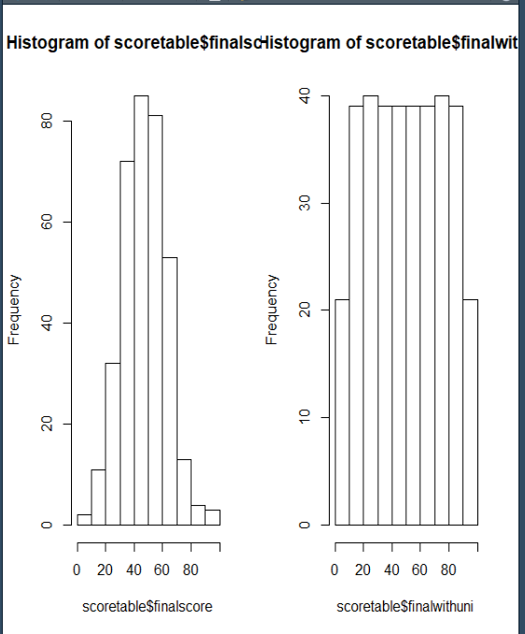
Combined Scores
Var Importance for all score
#talent_score 0.41852 -> make .3
#connect_score 0.27799 -> make .25
#cost_score 0.29656 -> make .3
#quality_score 0.00492 -> make .15
THESE CAN BE CHANGED BY THE USER…JUST SETTING DEFAULT
Prefer normal or uniform?

